Slide 1

Task 9 Simple Animation Battle of the Bands
Ruben Panzich – AIT Unit 2

Slide 2
Project Brief
I will be making a web video advertisement using many creative tools such as Premiere Pro, After Effects, Photoshop and Blender. It will include the information on where it is, when it is (time & date), who will be there and correctly represent conveyed themes of said artist(s). It will be exported as a MP4 file format as it is going onto a HTML5 website, and that video format is the best choice.

Slide 3
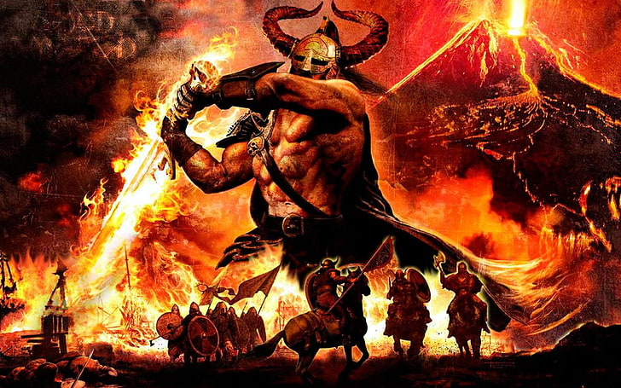
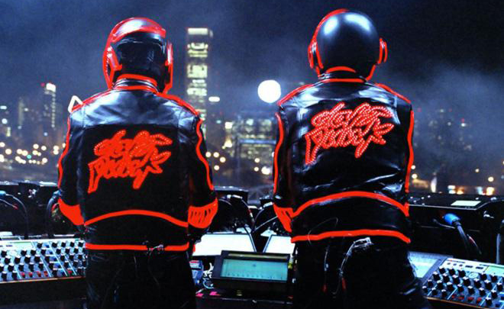
Brainstorm
Type - I can make use of both 3D and 2D animation along with other videos relating to the artists.
Theme - I could go for more of a rock styling with pyrotechnics or even a more of a techno futuristic theme. There will also be use of the Hale school branding as they are involved with it.
Goals - There will be use of text, images, videos and 3D models to convey the information about the event listed in project brief.
Purpose - The purpose of the advertisement is to inform the viewer of the information of the event while also peaking their interest.
Artists - Stormzy, Dave, Aitch and AJ Tracy.
Time & Date – 8 pm September 10th

Slide 4
Design criteria
I am going to use the Hale colours (Dark blue #00204E | Light Blue #AACAE6 | Yellow #F5CF47 | Black #000) along side their logo while following their style guide when representing their corporate image.
My primary age group is Males living in Australia from 14 – 18, mainly English speaking as that is the majority of the population. Text will have audio along with it to ensure accessibility for the disabled.
The product will be used as an information resource and incorporate video, photo, text and audio to meet the client’s brief while also being accessible.
It is going onto a website running HTML5 and therefor the recommended video format is mp4.
I’m going to use 2340x765 resolution for the banner giving it a aspect ratio of 3.06:1
I’m going to make use of emphasis through colour and contrast along with form of context and rule of thirds to achieve my goals.

Slide 5
Characteristics of target audience
Ethnicity – Gender is primarily male as that is the main audience of my artists.
Age – Mainly from 14-18 as that is where the type of music is most popular.
Language – My target audience consists of primarily people that can speak English.
Socio and Economic status – My target audience is the middle to upper class as they would be the classes that could afford to usually go to concerts.
Technology – They would need to have some understanding of technology to see the add and buy a ticket but given the target age they should be fine with that.

Slide 6
Requirements of the target audience
To access the battle of the bands they will need to have some amount of money to be able to buy a ticket along with a computer to first see the ad and also place their order.
They need to get to Hale school for it.
They need to have an interest in the type of music else that will not be interested by the advertisement or want to attend.

Slide 7

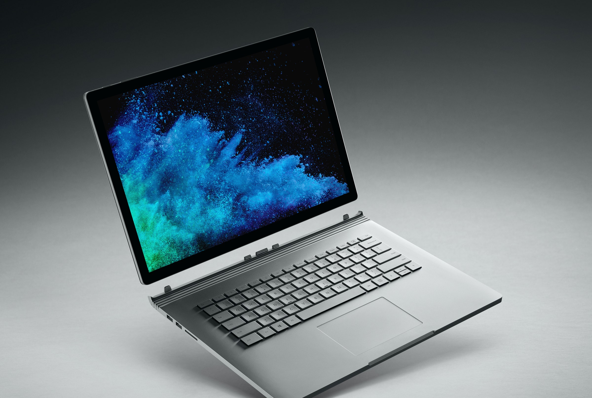
Technology
Hardware:
AIT Computers - Intel core 17-770 3.60GHz, 16Gb of RAM and Nvidia Quadro M620.
Surface Laptop - Intel Core i5-8350U 1.70GHz, 8Gb of RAM and Intel integrated graphics.
My PC - AMD Ryzen 3800xt, 32Gb of RAM at 3200MHz and Nvidia GTX 1070 OC

Slide 8


Technology
Software:
Adobe After Effects – Graphics and Media – A video editing sweet primarily designed for digital graphics and special effects – I’m going to use it for all video transitions, video editing and audio work.
Blender – Graphics and Media – A open-source piece of software capable of 3D modelling, texturing, rendering, shading, compositing, 2D animating along with many other features – I am going to use it primarily for creating video composition layers containing 3D models.

Slide 9
Development of design plan
We are using structured development process where we work in a linear order:
Project brief
Brainstorm
Design criteria
Characteristics of target audience
Requirements of target audience
Storyboard
Technology
Development of design plan
Time plan
Record of development
Production
Peer evaluation

Slide 10
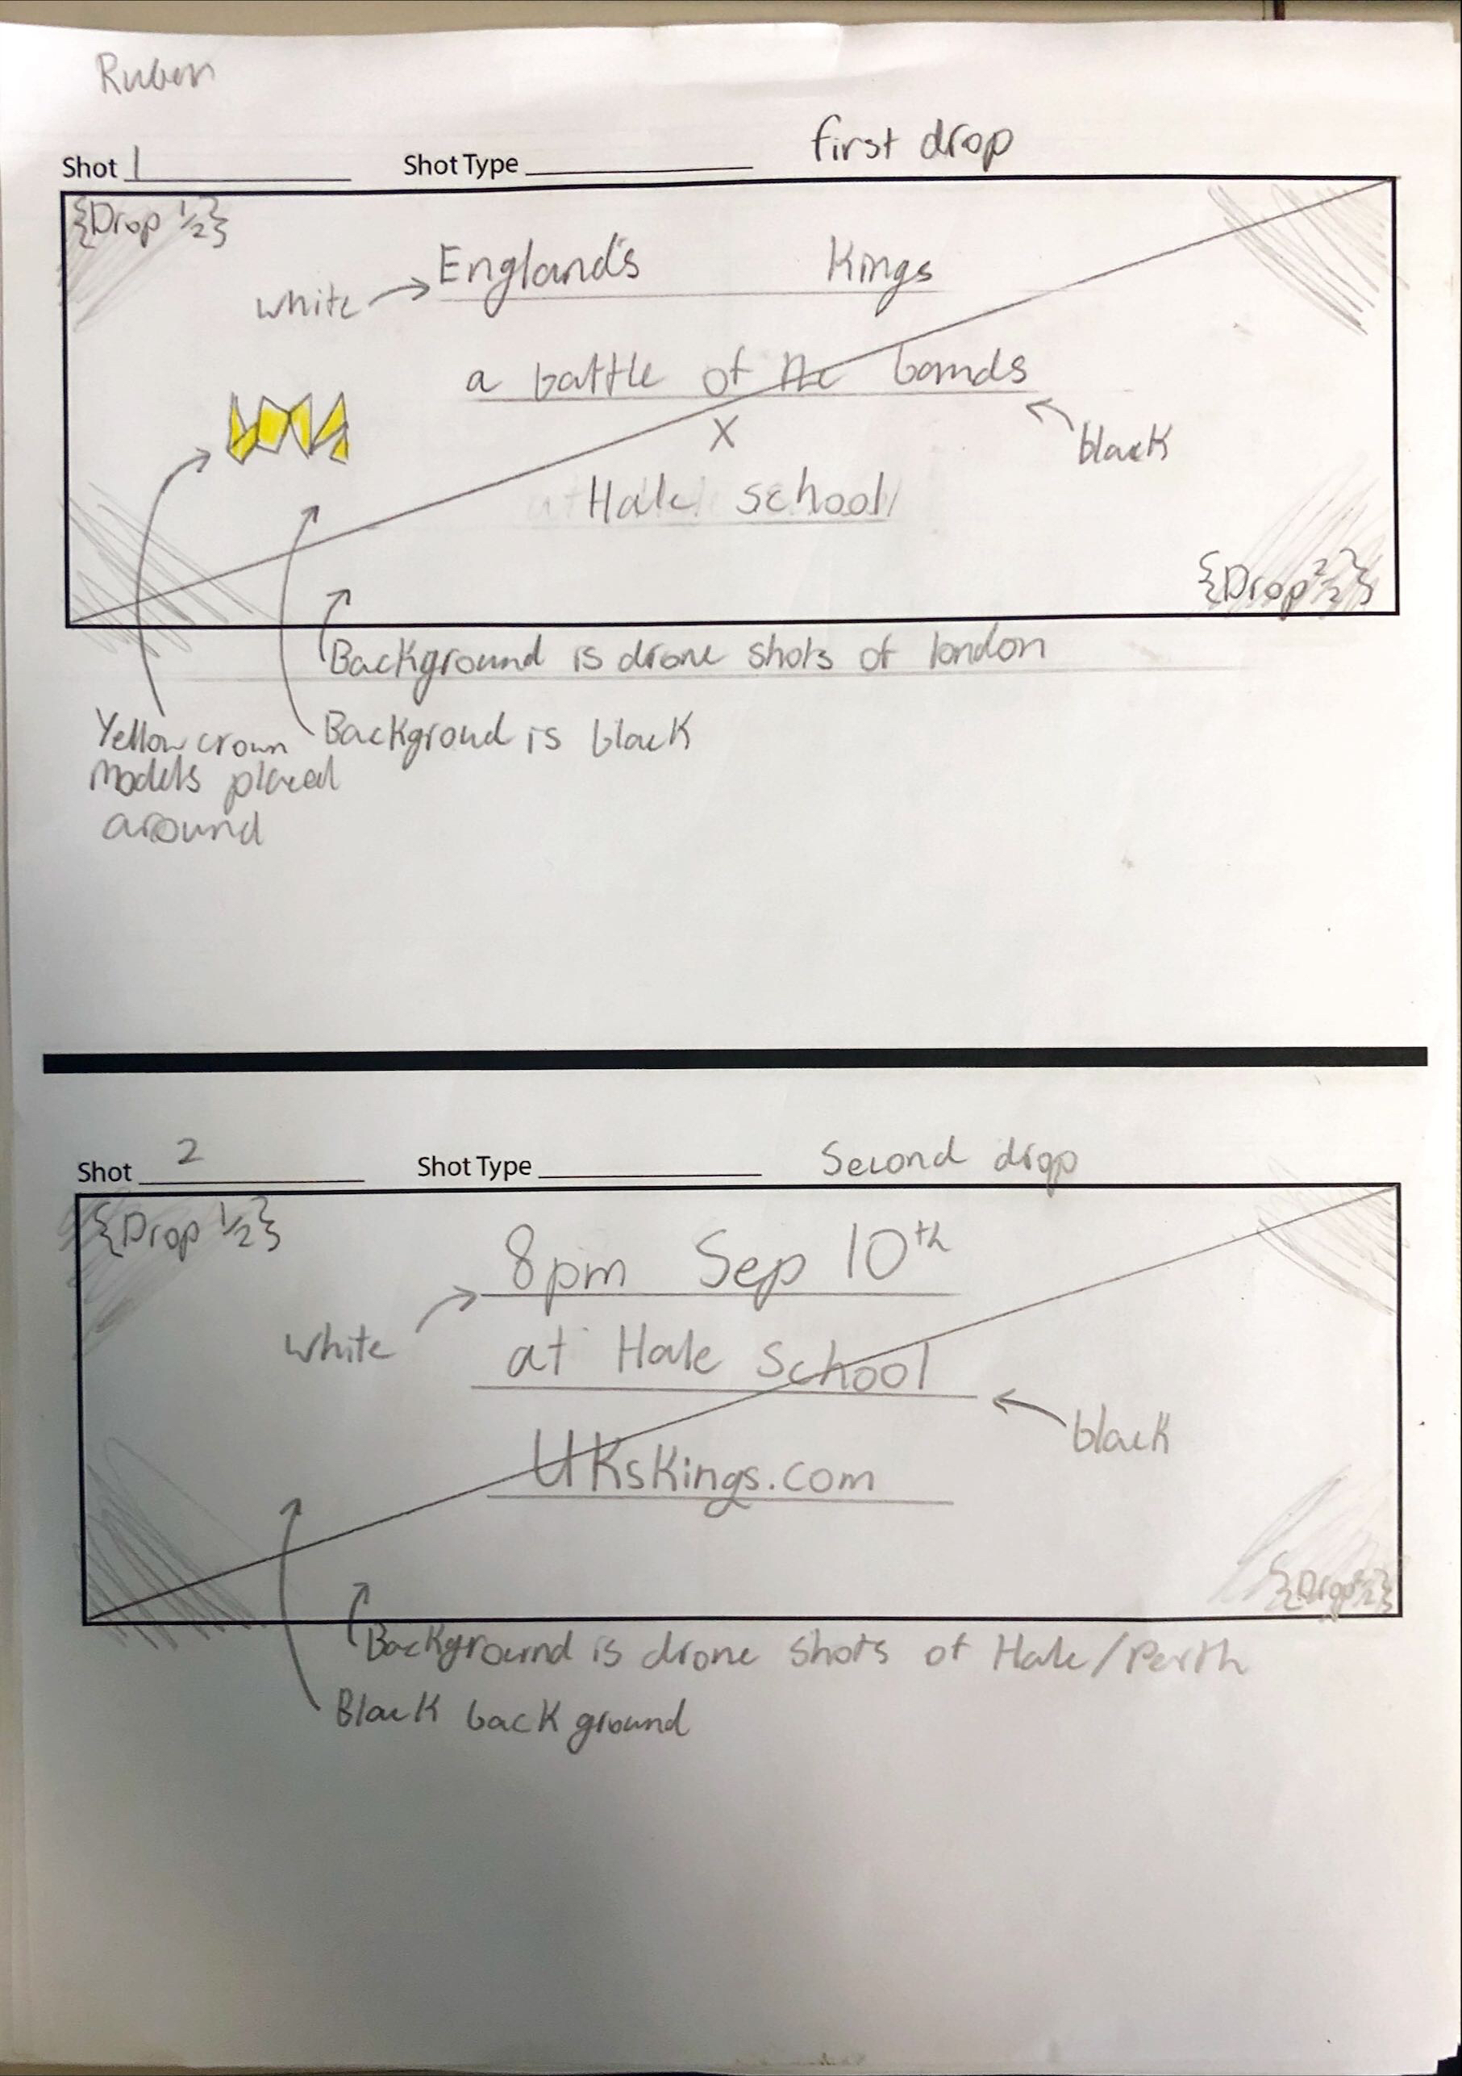
Annotations of design plan

Slide 11
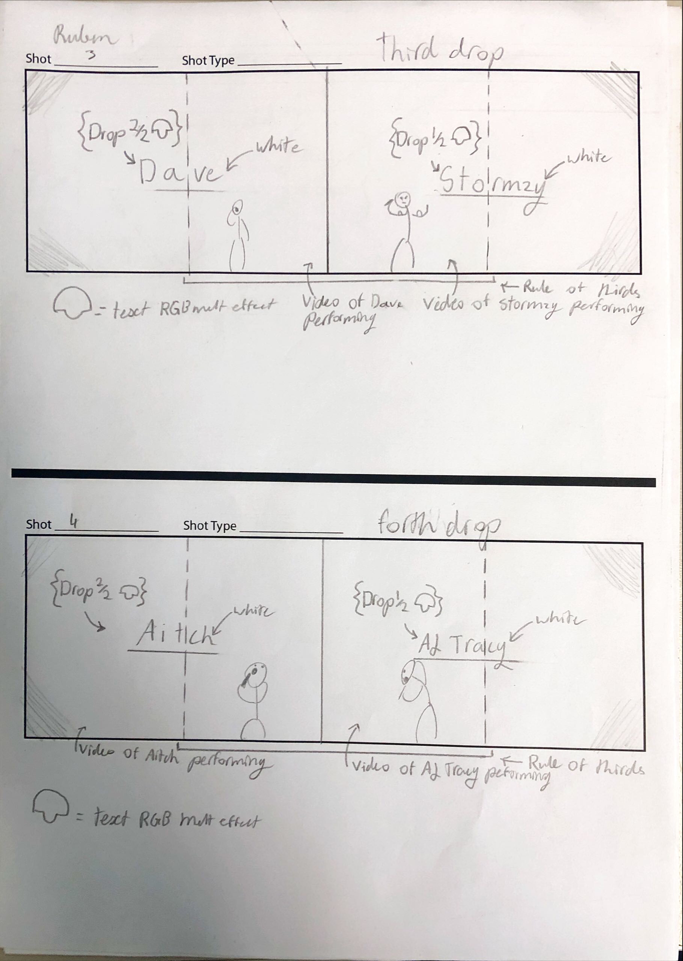
Annotations of design plan

Slide 12
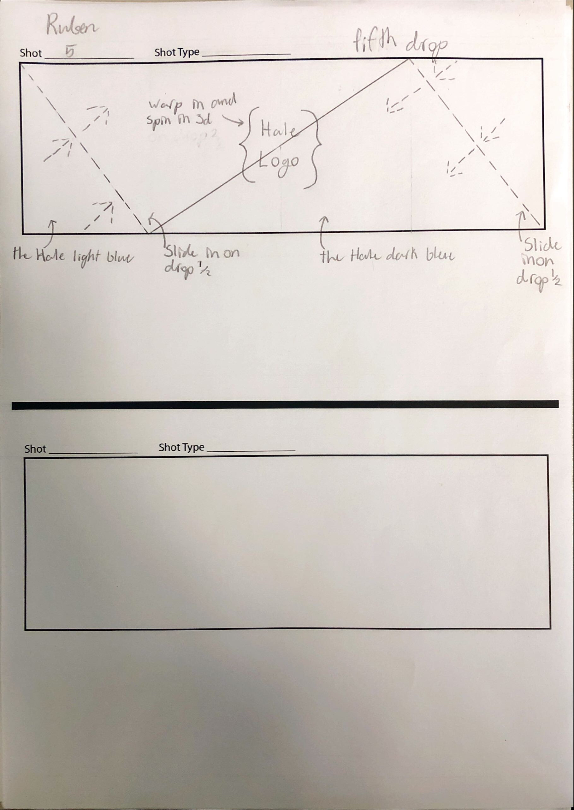
Annotations of design plan

Slide 13
Peer evaluation question
Did the advertisement appeal to target audience and was it engaging/understandable?
Yes, it made use of audio, video and text while also syncing them up keeping the viewer engaged and entertained while also making the text understandable when meant to be read.
Were different forms of the media in video used?
Yes video, text and audio were all used.
Were video editing techniques made use of?
Yes, the eyes line up on the first frame when Dave and Stormzy appeal along with the last frame and the first frame of the Aitch and AJ Tracey footage.
Was it original?
Yes, it looked completely unique and creative while not overly abstract.
Did it convey the required information?
Yes, it conveyed all the necessary information through the use of text and audio for the visually or audially impaired.
Were the key themes conveyed?
Yes, it does convey the themes thanks to the use of footage of the performers and footage of London/Perth, plus also having one of the artists songs playing in the background synced up to audio helped set the mood, a nice added touch was the fact that the TTS was a British Male.
-Oliver Robson

Slide 14
Peer evaluation question
Did the advertisement appeal to target audience and was it engaging/understandable?
The advertisement included various effects which helped it appeal to the target audience, whilst maintaining the ability to be understood and engaging throughout.
Were different forms of the media in video used?
All forms of media were used in the advertisement including editing of the video and audio elements.
Were video editing techniques made use of?
The advertisement used video editing techniques to keep the eye level of the two artists at the same height.
Was it original?
Almost all aspects of the advertisement were original, with the only exclusion being the editing done to text, however it stayed engaging even though I had seen something similar before.
Did it convey the required information?
All key information was shown in the advertisement, making sure the audience knows when and where the event is being held.
Were the key themes conveyed?
The themes of the artists were represented well in the advertisement by the use of the 3D crown animation, footage from England, and music from one of the artists.
-Taj Lamont

Slide 15
Peer evaluation question
Did the advertisement appeal to target audience and was it engaging/understandable?
Yes, the video was engaging by incorporating multiple forms of media such as audio, video and text to help make it more engaging.
Were different forms of the media in video used?
Yes video, text and audio were all used.
Were video editing techniques made use of?
Yes, the advertisement used video editing techniques to keep the eye level of the two artists at the same height.
Was it original?
Yes, it looked completely unique.
Did it convey the required information?
Yes, it conveyed all the necessary information through the use of text and audio for the visually or audially impaired through the forms of multiple medias.
Were the key themes conveyed?
Yes, it does convey the themes due to the use of crown symbols portrayed within the video and the use of background of London did also convey the theme with use of UK artists in video and audio form
-Arnav Patel

